Slide 1
GOOD HOUSEKEEPING IS
SAFETY
Hernando E Arriola
Faculty
College of Engineering

Slide 2

I would say that my role model, as far as just somebody leading by example, which to me is what a great youth counselor does - they are there to talk to and lead by example - would be my mom, but she wasn't a youth counselor. She was a teacher, and she is a good person and definitely one of the biggest influences in my life.
Carrie Underwood
Jesus, take the wheel
Take it from my hands

Slide 3
At the end of this module you
will be able to understand the
importance of 5s , be familiarized
with common examples and
apply practical steps leading
to sustainable housekeeping
improvements in our workplace.

Slide 4
DEFINITION OF 5S
Checklist for good house-
keeping to achieve greater
order, efficiency and
discipline in the workplace

Slide 5
There are two approaches to problem
solving. The first involves innovation-
applying the high-cost technology
such as state-of-the art computers
and other tools, investing
a great deal of money

Slide 6
The second uses commonsense tools,
checklists, and techniques that do not
cause much money. This approach
is called KAIZEN.
Kaizen means “improvement
or change for the better”.

Slide 7
Everyone in the organization must
work together to follow ground rules
for practicing kaizen:
Housekeeping (5S)
Waste elimination
Standardization

Slide 8
Housekeeping is an indispensable
ingredient of good management.
through good housekeeping,
employees acquire and practice
self-discipline. Employees without
self-discipline make it impossible
to provide products or services of
good quality to the customer

Slide 9
Elimination of waste. Anything
that does not add value is
a waste. 5S is a step by step
process where in a lot of waste,
unnecessary items, will be sorted out
with possibility that it can be recycled
or re-used. MUDA( WASTE) elimination
And 5S go hand in hand.

Slide 10
Improvements do not necessarily be
BIG. Start with small improvements.
such small improvements in many
processes or areas gradually
accumulates, leading to significant
quality improvements.
KAIZEN INVOLVES EVERYBODY
Starting from CEO in the
organization, planning and working
together.

Slide 11





























When 5S has been successfully implemented in the company, the effect are as follows:
Increase roductivity
Increase Product
uality
Reduce Manufacturing ost
Ensure on-time
elivery
Provide a afety working environment

Slide 12
5s = P+ Q + C + D + M
Where:
P= Increased Productivity
Q= Improved Product Quality
C= Reduced Cost
D= Ensure on time Delivery
M = improve the morale of employee
Increase Product
uality
Reduce Manufacturing ost
Ensure on-time
Provide a afety working environment

Slide 13
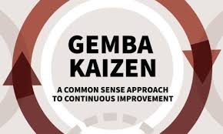
GEMBA- KAIZEN

Slide 14
In Japanese gemba means real place-
the place where real actions occurs.
Japanese use the word gemba in
their daily speech. When earthquake
shook Kobe in 1995, TV reporters at
the scene referred to themselves
as “ reporting to gemba”; in the back-
ground, one could see houses
In flames or collapsed elevated
highways.

Slide 15
Within Japanese industry, the word
gemba is almost as popular as kaizen.
during discussions, when a visitor
heard the word kaizen within the first
5 minutes and the word gemba within
The first 10 minutes, then they will
Conclude that it must be a good
company

Slide 16
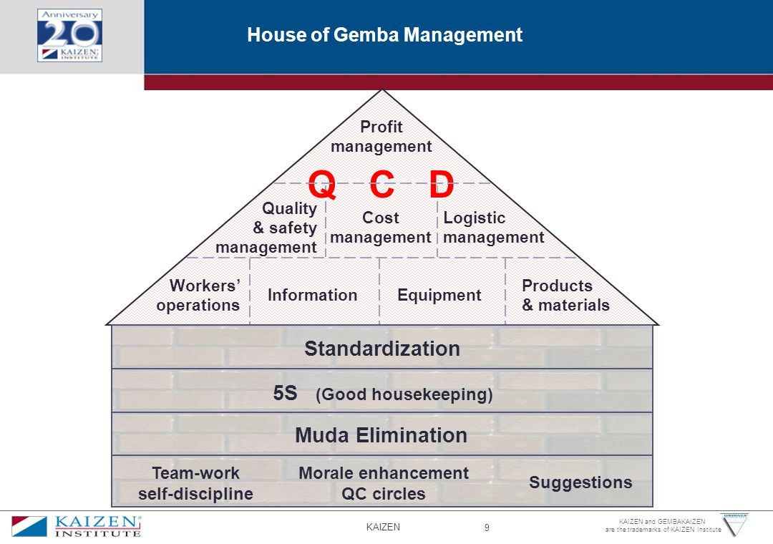
TAKE NOTE OF
THE SIGNIFICANT
PART OF 5S
(GOOD HOUSE
KEEPING in
GEMBA
MANAGEMENT

Slide 17
The house of gemba shows a bird’s
eye view of activities taking place in
gemba that helps attain goals
related to Quality , Cost and Delivery.
A company that produces quality
products or services at a reasonable
Price( cost) and delivers them
on time . Later we will
find out how 5S helps in this aspect.

Slide 18


Slide 19
GEMBA WALK simply means
as managers, we do not stay
within the four corners of our
office, we should visit the real
place where the actions or the
activities are going on.

Slide 20
The 5s of good housekeeping :
The 5s stand for five Japanese words
that constitute housekeeping . Today,
practicing the 5s has become
almost a must for any company engaged
in manufacturing. An observant gemba
management expert can determine the
caliber of a company in 5 minutes by
visiting the plant….

Slide 21
And taking a good look
on what goes there especially in
regard to waste(muda) elimination
and the 5s
A lack of the 5s indicates
inefficient self-discipline, low morale
of worker, poor quality, high cost
and an inability to meet delivery terms

Slide 22
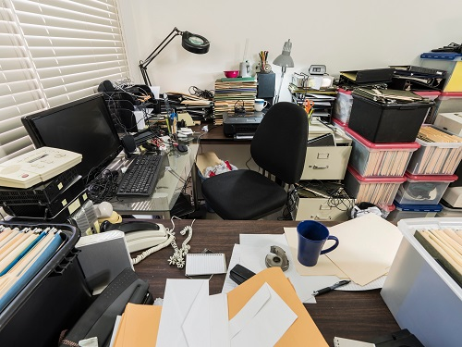
If seen during gemba walk
What would be the impression ?

Slide 23
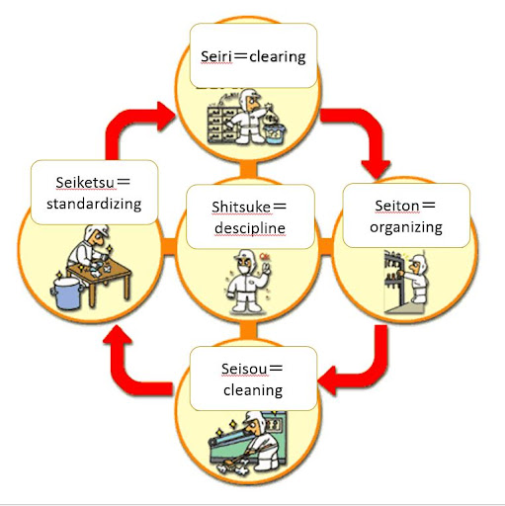
The 5s’s: the five steps of
of housekeeping

Slide 24


Seiri
Sorting Out or Pagbubukod
Means to segregate the
“Ones Needed” and “Others Not Needed”
and to put only the Ones Needed in the Workplace

Slide 25
Seiri( Sorting out )
Red tag to mark items that
perceived unnecessary . The rule
of thumb is decision must be
done within 30 days on the marked
items

Slide 26
Seiri( Sorting out )
Usually, our working area is full of unused objects kept on our area for
“decade”
Some of things unnecessary can be useful to other department
Some that are still useful and needed within a month period can be retured
to their rightful places

Slide 27
Seiri( Sorting out )
Sorting will help us realized that we are keeping huge amount of inventory, things that we could have
acquired unnecessarily as if we had
“panic buying” before an impending
calamity.
We will be able to optimized buying.

Slide 28
Seiri( Sorting out )
Upon discovering heap of supplies,
We could ask ourselves,
What system to we have for placing orders?
What is our basis for maintaining
Supplies ( over buying?) we should be able to determine
Minimum and maximum inventory

Slide 29
Seiri( Sorting out )
Eliminating unnecessary items allow us to free up some space, enhancing
flexibility in the use of the working
Area.
Let us begin with our own drawer
( ouch!!!)

Slide 30

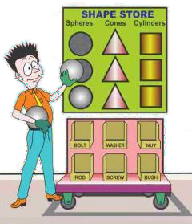

Seiton
Organizing or Pag-aayos
Putting things “To Set in Order”
or put things needed on proper place

Slide 31











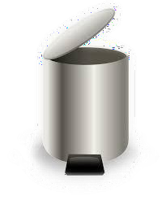

Seiton Procedure
Things should be placed as follows
Used every week to a month
Put on place near you
Used every 2~6 months
Put on Nearer Shelf
Used every 6 months
Put on Further Shelf or Location
Used less than a year
Evaluate future use to decide further storage or disposal

Slide 32
SEITON ( ORGANIZING)
Classifying items by use and arranging
Them to minimize search time and
effort.
Each item must have designated place,
name, and volume(allowable qty to keep)
Flooring is marked where to place
table, chairs, cabinet
( if un marked, then probably, it should not be there !

Slide 33
SEITON ( ORGANIZING)
Silhouettes may be drawn where
tools are to be stored so we could
easily figure out where to return the
items. Likewise, we could easily
determine if unreturned or missing.
In manufacturing, checking of
these tools must be done at the
start and before end of work.

Slide 34
SEITON ( ORGANIZING)
Lines on the floor use different colors
of paint or tapes, to distinguish
good products from defective parts
or good to use tools from tools for
repair or for checking.

Slide 35
SEITON ( ORGANIZING)
Lines on the floor use different colors
of paint or tapes, to distinguish
good products from defective parts
or good to use tools from tools for
repair or for checking.

Slide 36

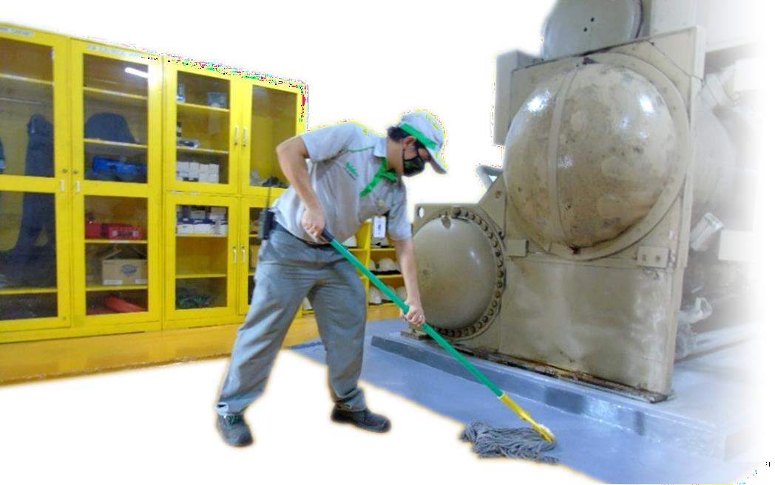
Seiso
Cleaning or Paglilinis
Cleaning frequently. All members join to clean together. Find the cause of dirt and take action to Prevent it.

Slide 37
SEISO (SCRUB, CLEAN)
SEISO means cleaning the working
environment, including machines and
tools
as well as the floors, walls and other
area of the workplace.

Slide 38
SEISO (SCRUB, CLEAN)
Seiso is checking, for example
an operator cleaning the
machine can find many
malfunctions when the
machine is covered with oil,
soot and dust.
.

Slide 39
SEISO (SCRUB, CLEAN)
Seiso is checking
While cleaning the ceiling , walls and
flooring of our house, we may discover
faulty electrical wire which could
have caused fire or someone
be electrocuted.
.

Slide 40

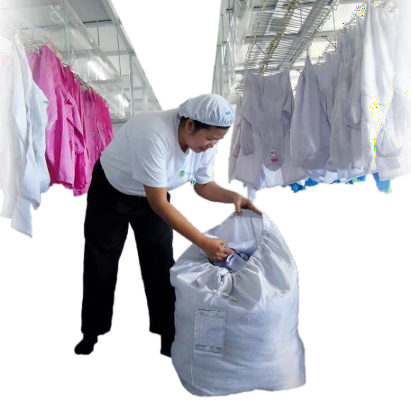
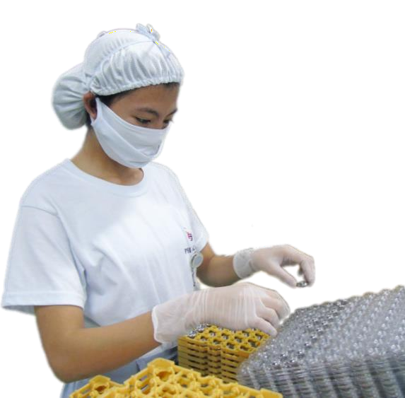








SEIKETSU ( SYSTEMATIZE)
Example
Wash uniforms following
the Rules
Using Gloves on
handling Parts
Not using any form
of Cosmetics

Slide 41

Keeping ourselves clean such as
wearing proper working clothes
( Japanese usually wears uniforms)
safety glasses, gloves, and shoes
while maintaining a clean and healthy
environment.

Slide 42
How seiri, seiton and seiso should
take place and who should lead per
area while promoting 100%
involvement
Good housekeeping activities
To be part of annual planning

Slide 43
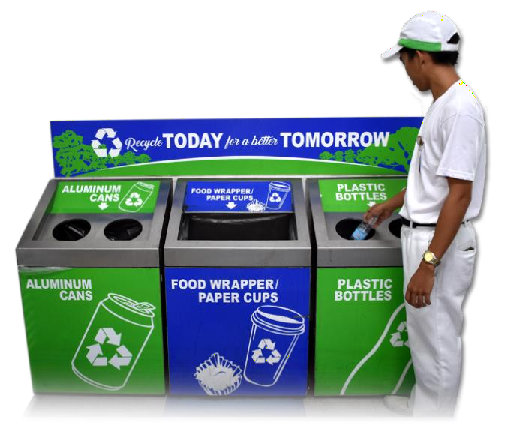
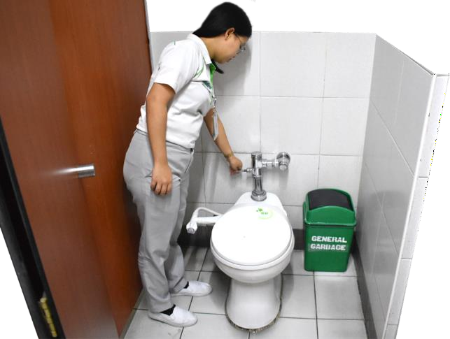
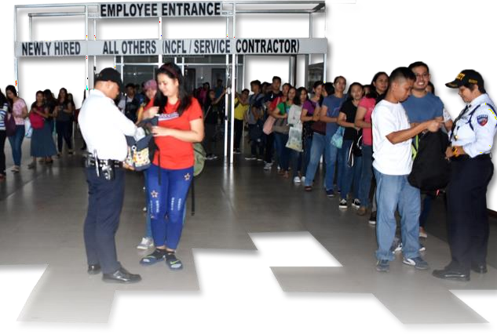







Shitsuke ( Standardize/Self-discipline)
Example

Slide 44
Shitsuke ( Standardize/Self-discipline)
SHITSUKE means self- discipline
People who continuously practice the
gains of 4S, who make a habit
of making these activities part of daily
work

Slide 45
Shitsuke ( Standardize/Self-discipline)
Employees must follow established
and agreed upon rules at each step,
and by the time they arrive at shitsuke
they will have the discipline
to follow such rules.
NO “ningas kugon”

Slide 46
Shitsuke ( Standardize/Self-discipline)
THE STANDARD SHOULD INCLUDE
WAYS ON HOW TO
EVALUATE PROGRESS AT EACH OF THE
FIVE STEPS

Slide 47
There are five ways to appraise the level of
Of 5S at each stage
Self- evaluation
Evaluation by an expert consultant
Evaluation by a superior
A combination of above
Competition among groups.

Slide 48
5s ( +2)
SAFETY - SAFE WORK
ENVIRONMENT, IDENTIFYING
AND ADDRESSING
HAZARD. BASIC OCCUPATIONAL
SAFETY AND HEALTH (BOSH)

Slide 49
5s ( +2) SAFETY
This principle emphasizes the importance of safety in the workplace and involves identifying and mitigating potential hazards. It also includes implementing safety procedures and training employees on safety protocols.

Slide 50
5s ( +2)
7. SPIRIT – FOSTER A POSITIVE AND
COLLABORATIVE WORK
ENVIRONMENT ENCOURAGING
EMPLOYEE ENGAGEMENT
AND MORALE

Slide 51
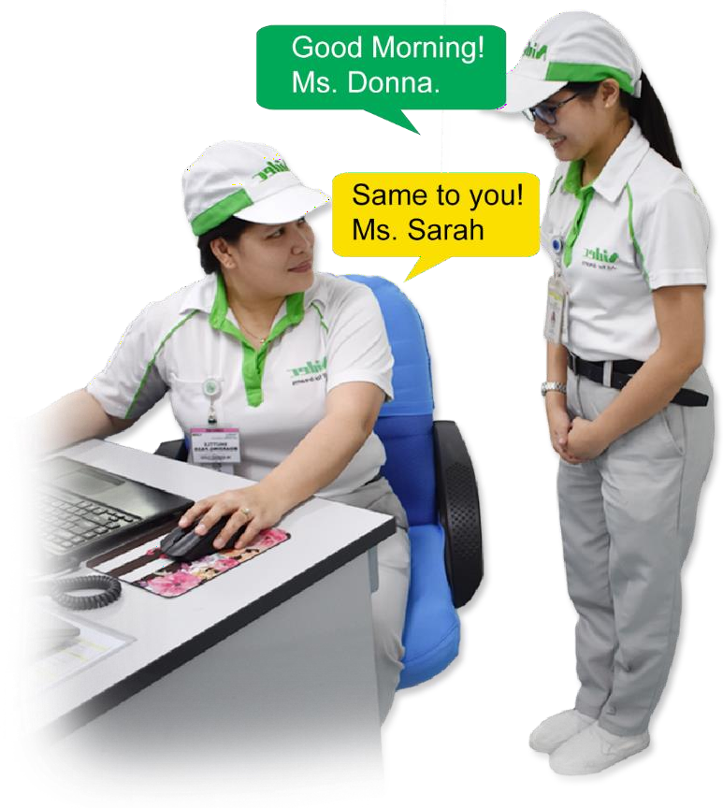
Means to behave the right way.
It is how you behave & talk on particular occasions
7. SPIRIT

Slide 52

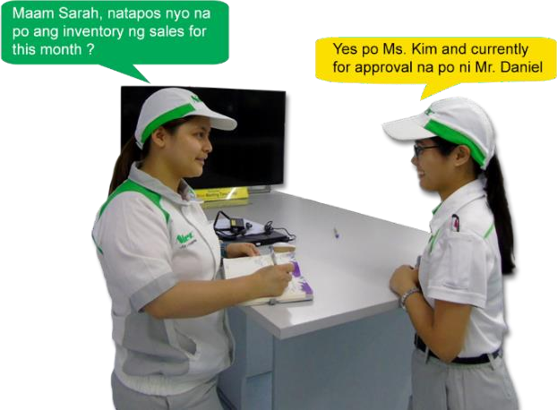
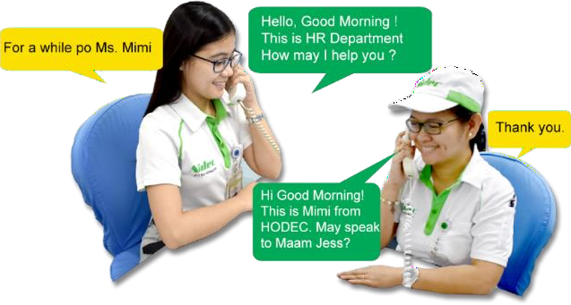










Example
7-SPIRIT

Slide 53
Taiichi Ohno, a key figure in the development of the Toyota Production System (TPS) and Lean Manufacturing, offered numerous inspirational insights. Here are some of his most notable words:
"Having no problems is the biggest problem of all."
This emphasizes the importance of continuous improvement and challenging the status quo.
"Wisdom is something you acquire by doing it."
This highlights the value of hands-on experience and learning from practical application.
"Where there is no standard, there can be no improvement."
This underscores the need for clear, defined processes before seeking improvements.
"Don't look with your eyes, look with your feet. Don't think with your head, think with your hands."
This encourages a practical, hands-on approach to problem-solving.
“Gemba Walk .

Slide 54
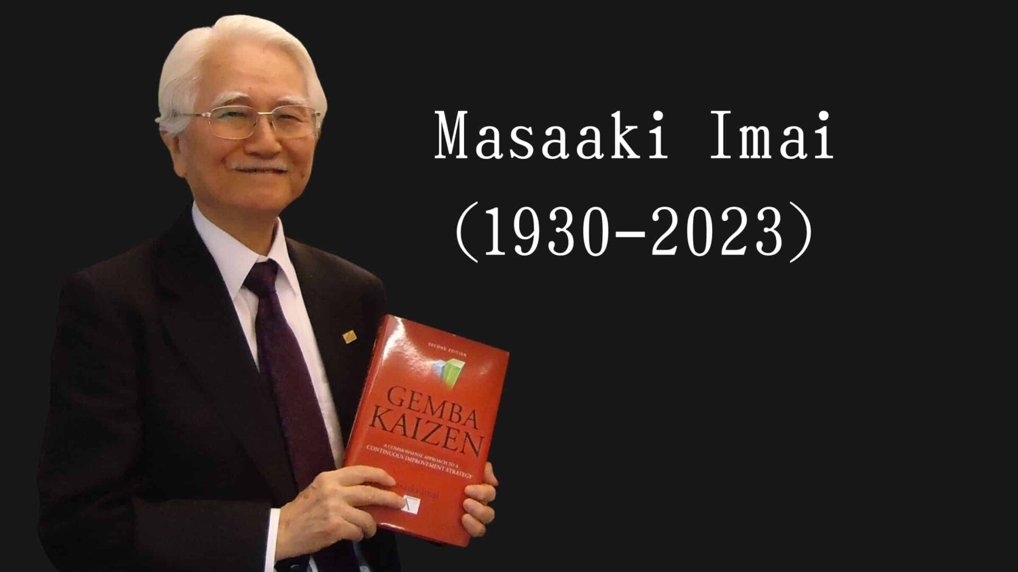

Slide 55
• 2:45 PM – 4:15 PM (1.5 hrs): Workshop / Group Activity
• 4:15 PM – 4:30 PM (15 mins): Sharing of outputs, synthesis, and wrap-up
II. Pre-Workshop Task (To Be Done Before INLET)
Each participant must:
1. Take clear, detailed photos of one specific area of concern in their respective school/office (e.g., cluttered cabinet, disorganized desk, messy stockroom).
2. The area must be real and familiar to them so they can analyze it well.
3. This will be the basis for the workshop task.
4. Propose at least 5 Alternative Courses of Action (ACA) to address the concern.

